Slide 1

Movie Success Insights: Statistics, Popularity and Timing Considerations
Team/Contributors
Sunil Malhi
Aysha Gheewala
Godswill Anyasor
Ayomide Olanrewaju
Mohammed Sadek Ahmed

Slide 2

Research Questions
How have movie ratings evolved over the years, and are there discernible trends within different genres?
Which movie genres reign supreme in popularity, and is there a correlation between a movie's genre and its commercial success?
Do certain directors or actors wield a significant influence on a movie's success or ratings?
How does the duration of a movie impact audience reception and ratings? Are longer or shorter movies more favorably received?
Is there a relationship between a movie's budget, box office performance, ratings, and how timing influences these dynamics?

Slide 3
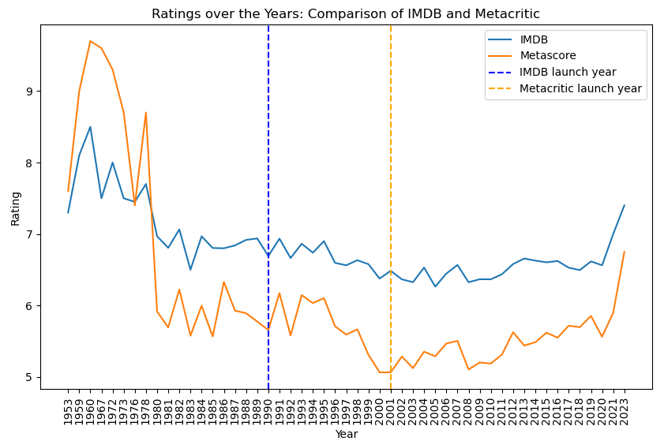
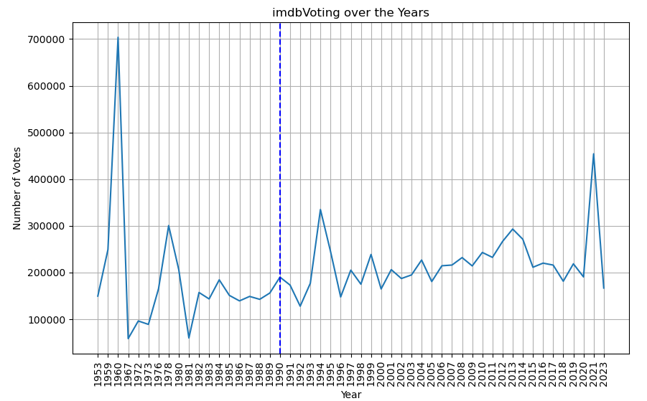
1. How have movie ratings evolved over the years, and are there discernible trends within different genres?

Slide 4
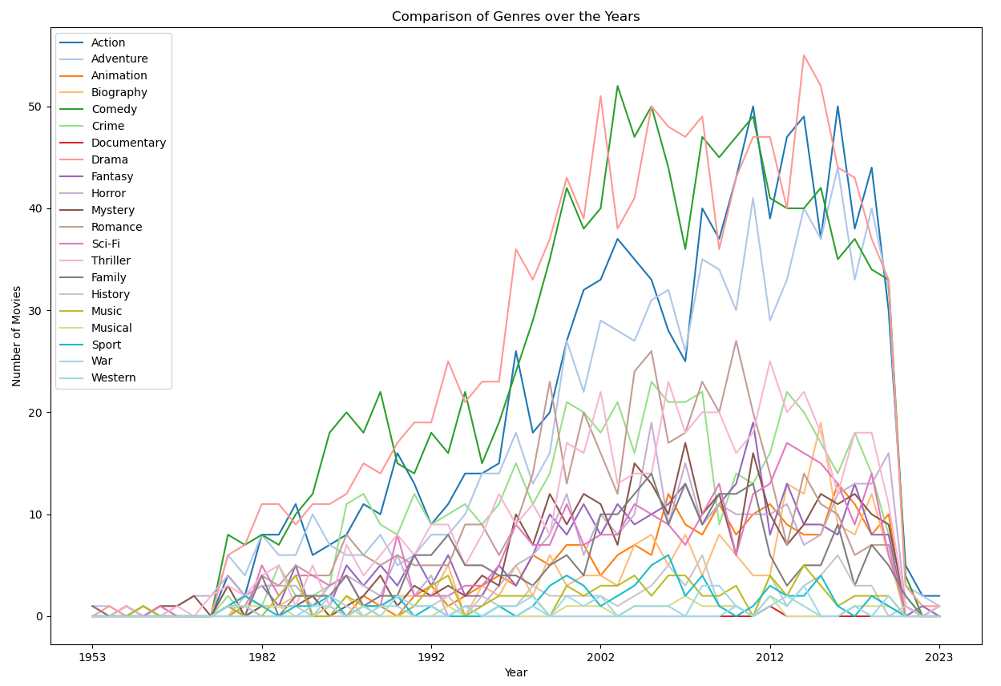
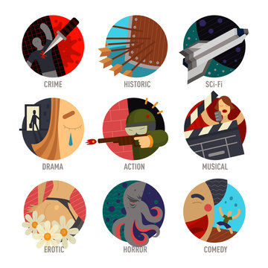
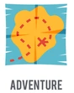

Slide 5
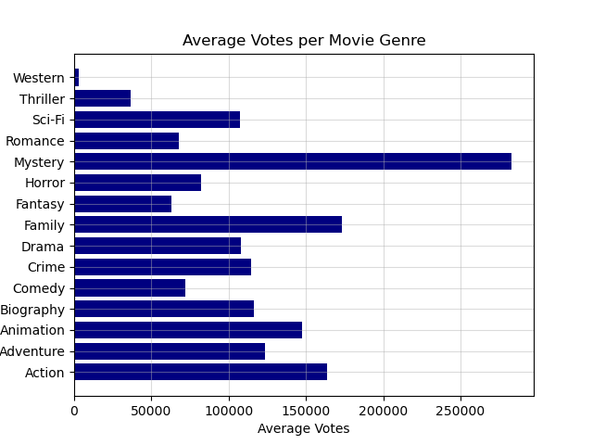
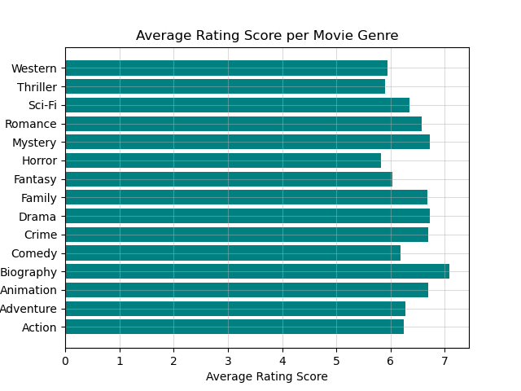
2. Which movie genres reign supreme in popularity, and is there a correlation between a movie's genre and its commercial success?

Slide 6
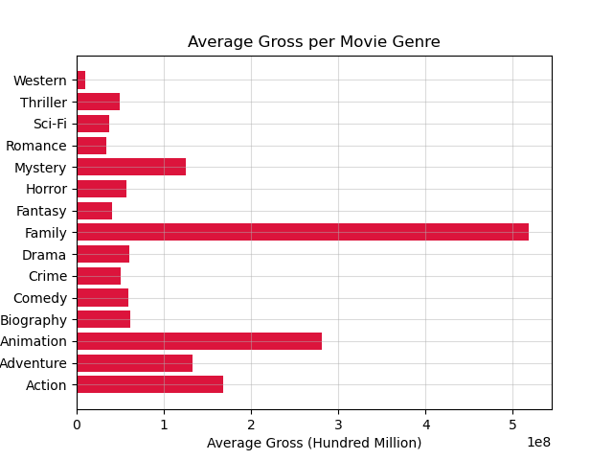

Slide 7
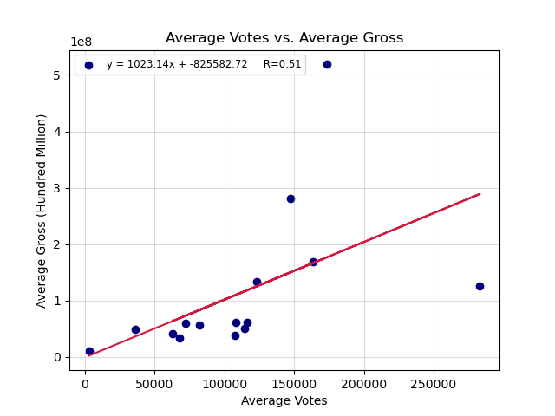
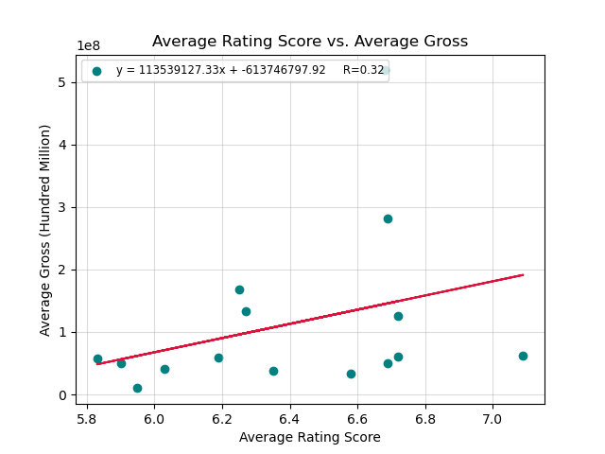

Slide 8
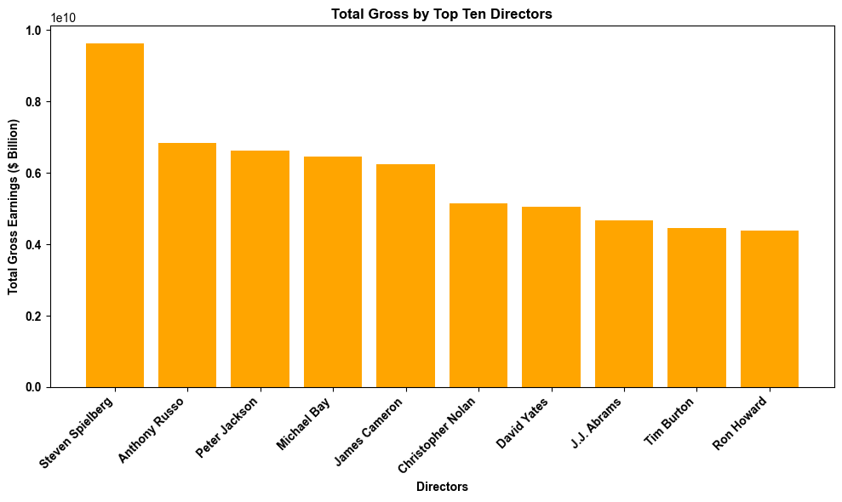
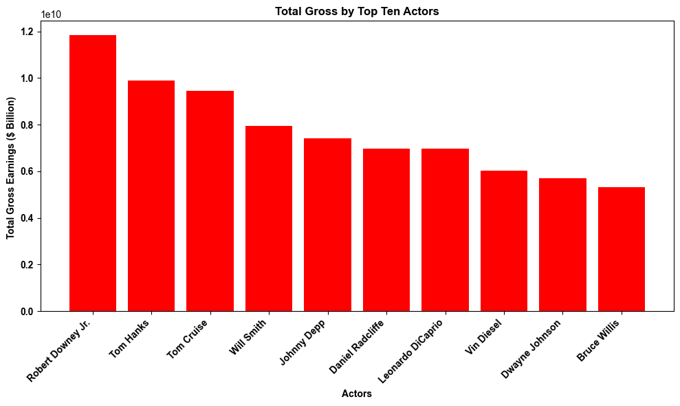
3. Do certain directors or actors wield a significant influence on a movie's success or ratings?

Slide 9
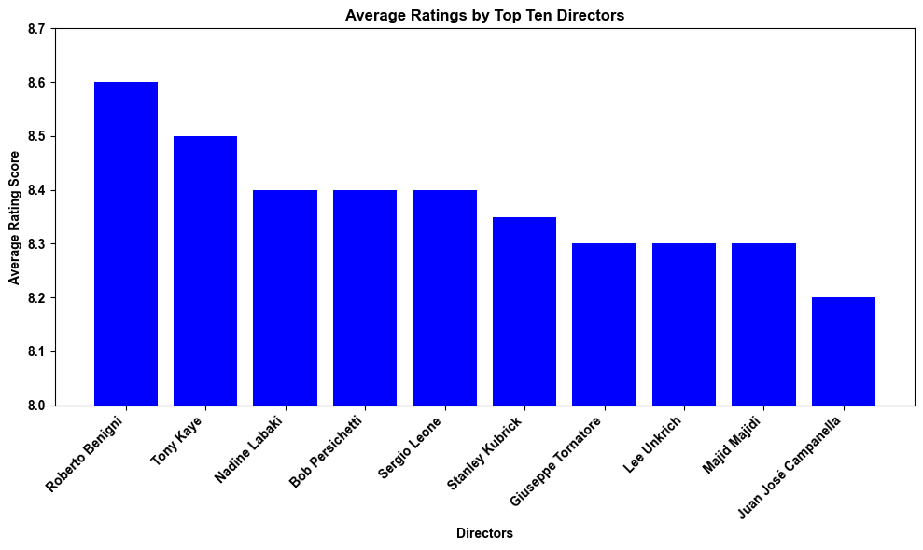
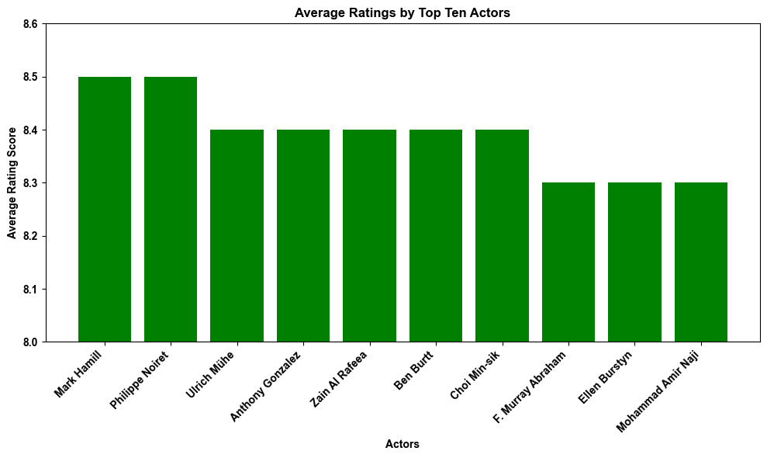

Slide 10
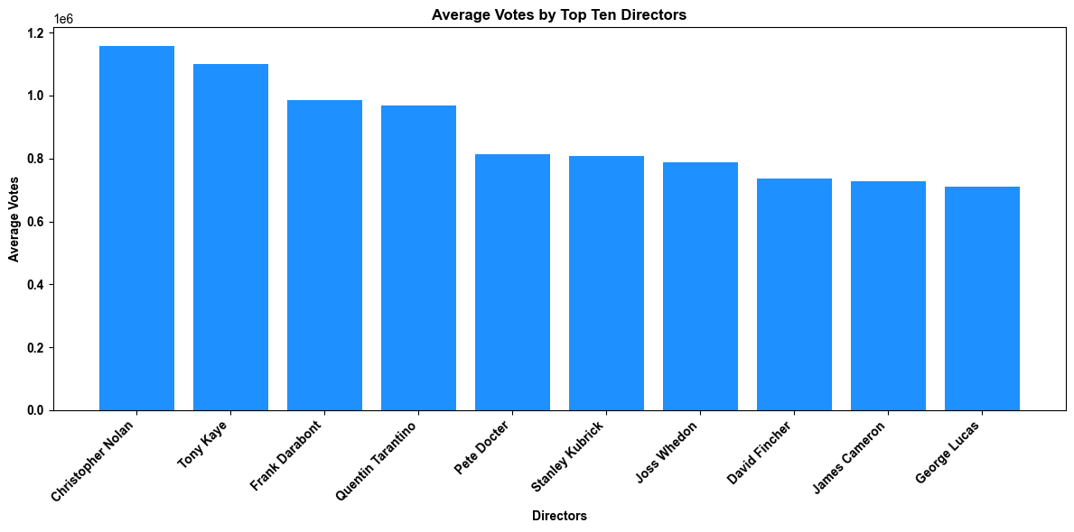
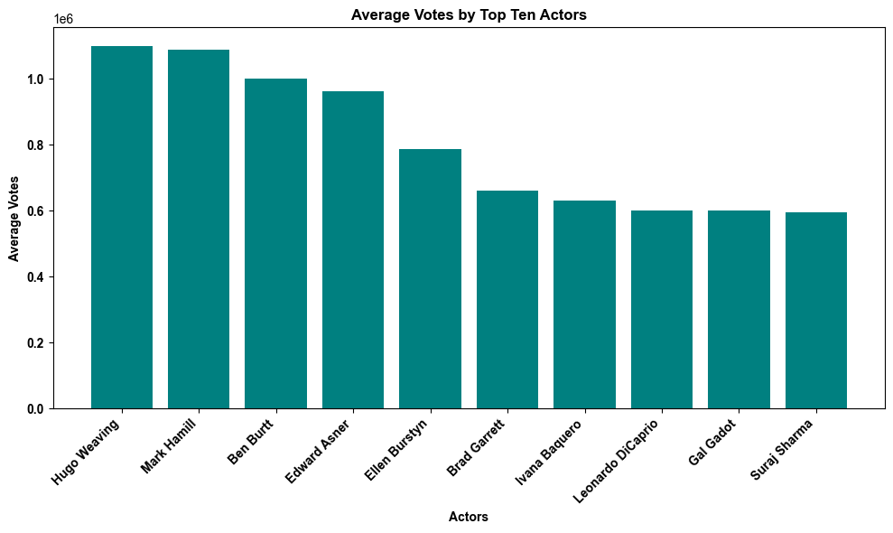

Slide 11
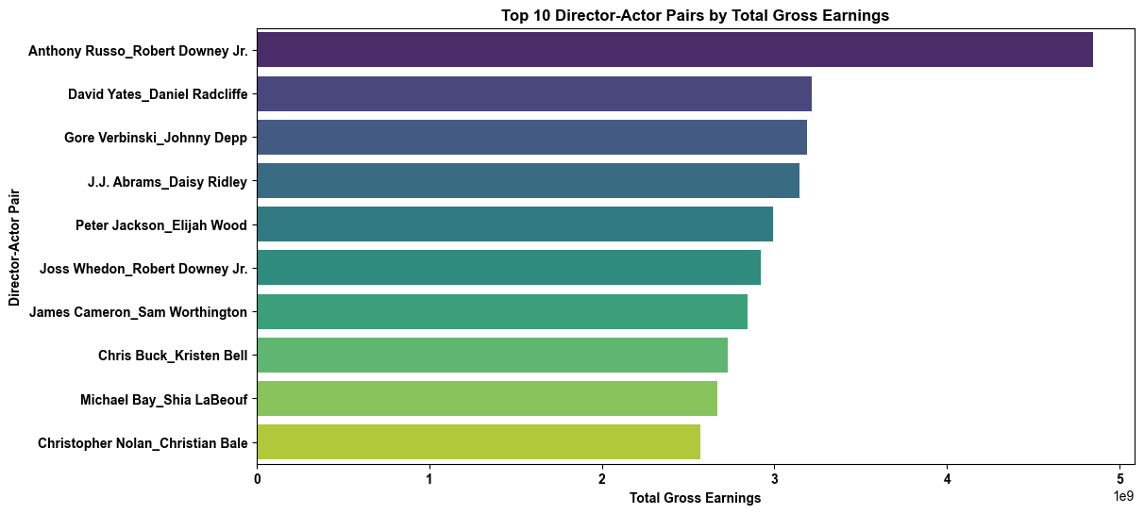
t-statistic: -1.3211, p-value: 0.1865, significant at p <0.05.

Slide 12
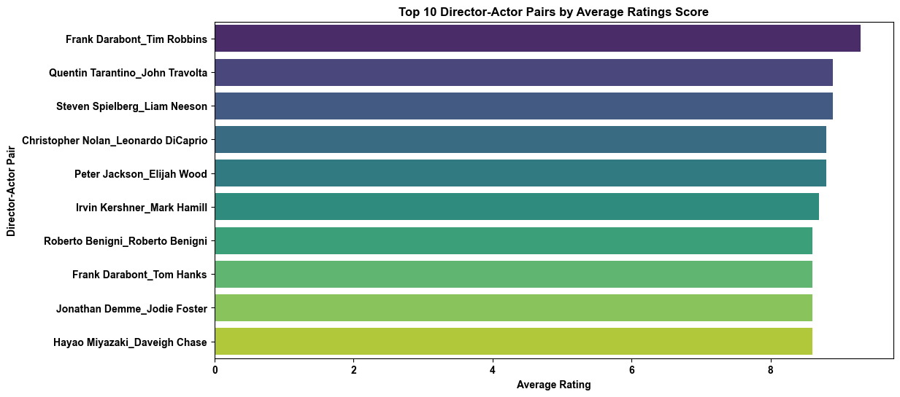
t-statistic: -1.9268, p-value: 0.0541, significant at p <0.05.

Slide 13
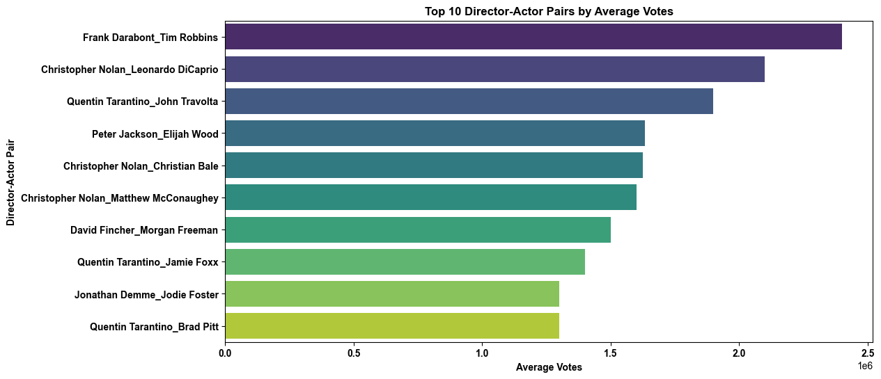
t-statistic: 0.0746, p-value: 0.9405 , significant at p <0.05.

Slide 14
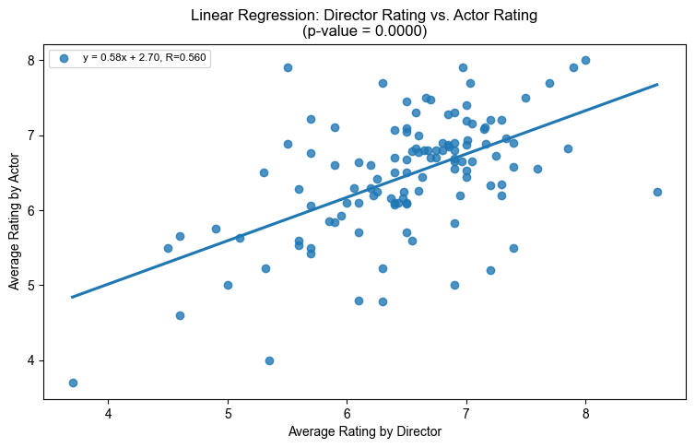
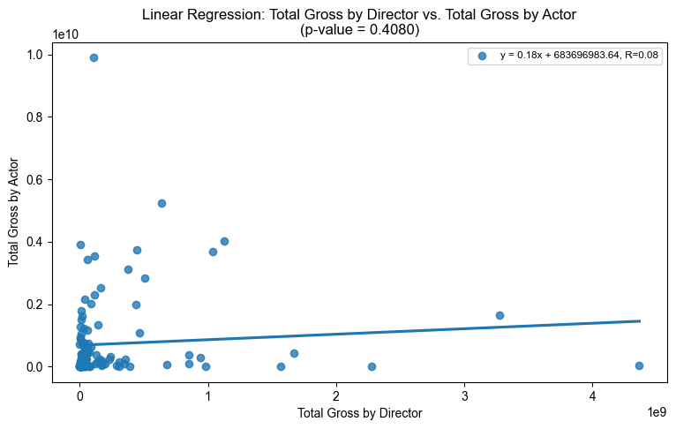
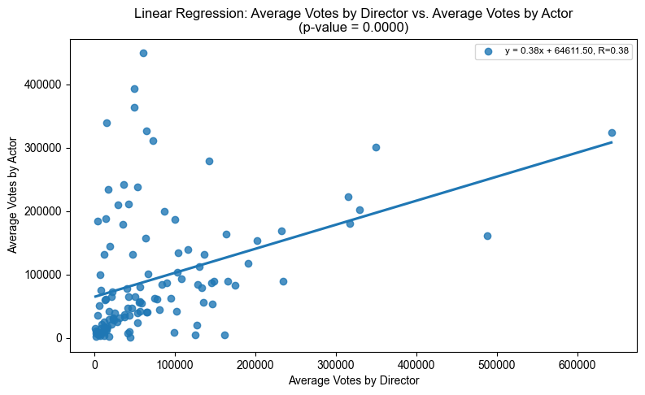

Slide 15
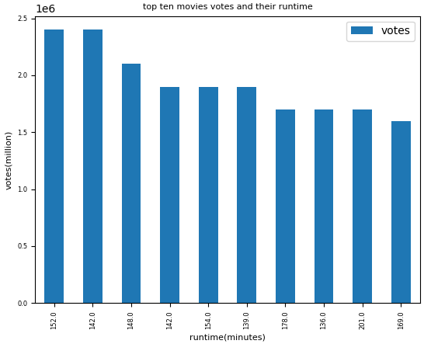

4. How does the duration of a movie impact audience reception and ratings? Are longer or shorter movies more favorably received?

Slide 16
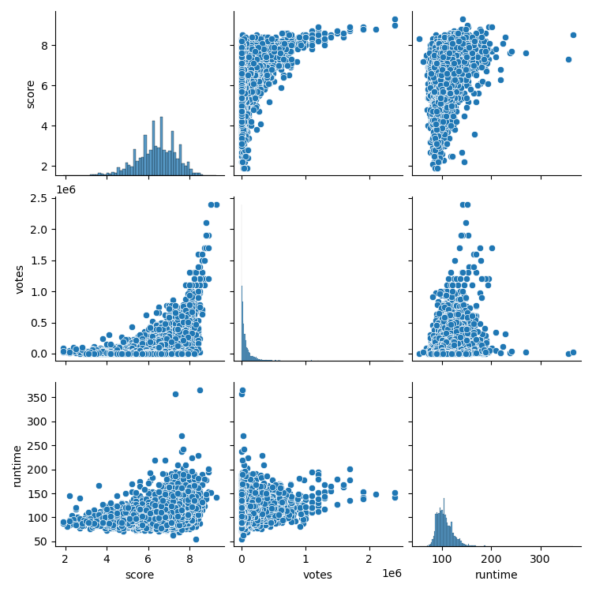
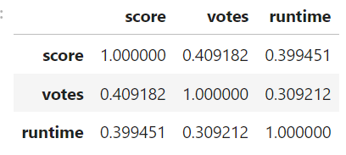

Slide 17
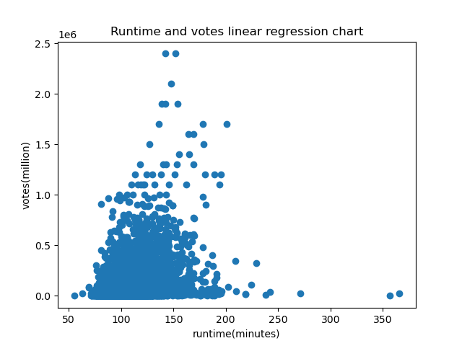

Slide 18
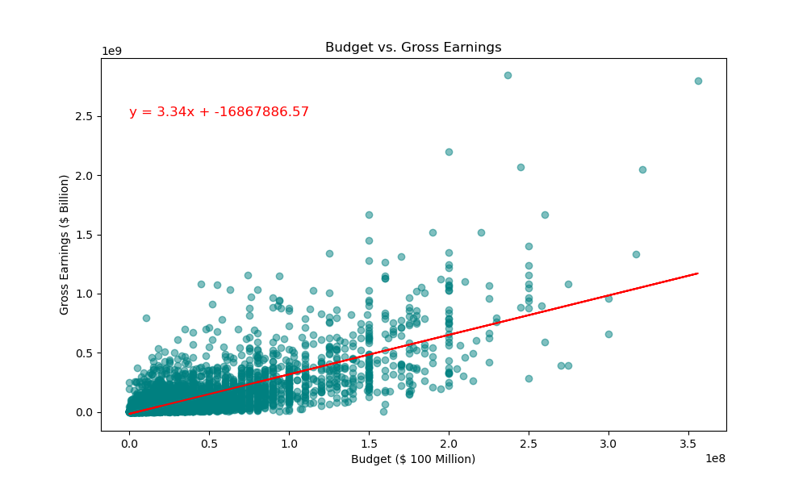
5. Is there a relationship between a movie's budget, box office performance, ratings, and how timing influences these dynamics?
The r value is 0.5476

Slide 19
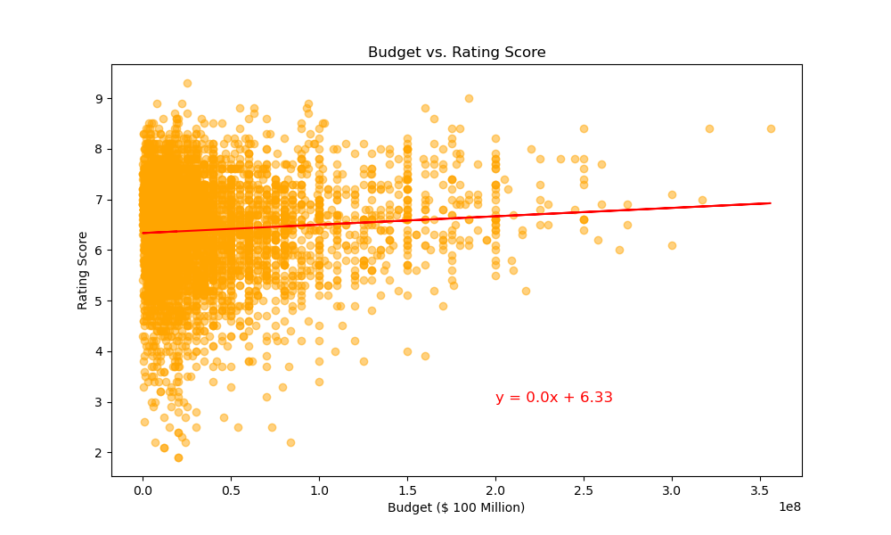
The r value is 0.0051

Slide 20
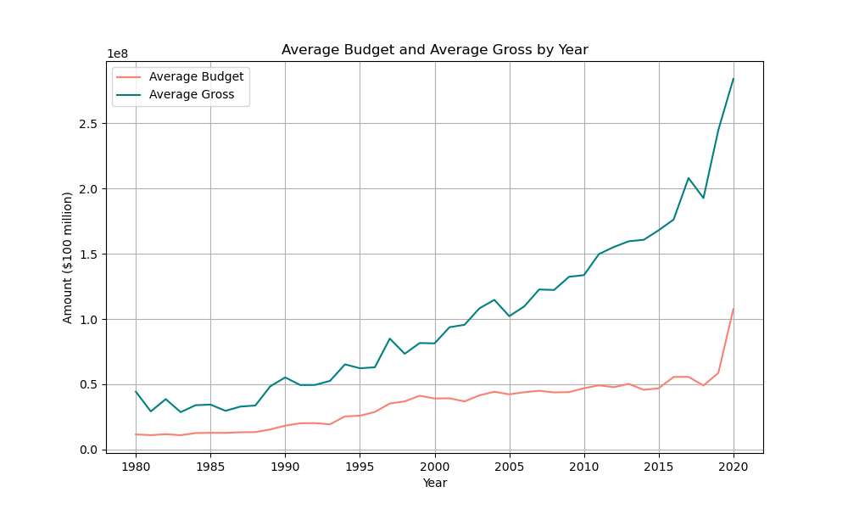
The coefficient value is 0.5476
The p value is 3.36e-19

Slide 21

Summary
Stakeholders can benefit by adopting strategic approaches to release, marketing, talent investment, budgeting, and adaptation.
These measures aim to navigate the dynamic landscape, contribute to impactful cinematic experiences, and establish a lasting influence in this competitive environment.
While a moderate correlation exists with some of the variables, it’s essential to consider other factors such as marketing strategies, script quality, competition etc. when making decisions.
It’s important to note that correlation doesn’t imply causation!

